Slide 1
Chinese Poetry Generation with
Planning based Neural Network
NAME: 郭天翼
DATE: 2017.10.12

Slide 2






INTRODUCTION
EXPERIMENTS
RELATED WORK
内容
CONCLUSION
APPROACHES
FUTURE WORK
Notes:
contents

Slide 3
INTRODUCTION
Employ rules or templates
(Tosa et al., 2008; Wu et al., 2009; Netzer et al., 2009; …)
Genetic algorithms
(Manurung, 2004; Zhou et al., 2010; Manurung et al.2012)
Summarization methods
(Yan et al., 2013)
Statistical machine translation methods
(Jang and Zhou, 2008; He et al., 2012)
Notes:
论文提到了这样几种诗歌生成的方法，包括采用规则与模板，使用遗传算法，摘要方法和统计机器翻译的方法

Slide 4
INTRODUCTION
Deep learning methods
(Zhang and Lapata, 2014; Wang et al., 2016; Yi et al., 2016)
1. Generate the first line according to the user’s writing intents
2. Generate the other three lines based on the first line and
the previous lines.
Problem:
The user’s writing intent can only affect the first line
The rest three lines may have no association with the main topic
Using modern terms may fail to generate meaningful poems
Notes:
近期，深度学习也被采用来实现诗歌生成。2014年与2016年的论文将诗歌生成看作序列到序列的生成问题。
这类方法通常是先依据作者的写作意图，从数据集中生成第一句诗，之后的三句诗依据先前生成的诗句来生成。
然而这类方法存在几个问题，首先，作者的写作意图只能影响到第一句诗，剩下的三句和主题基本没有关联，导致了语义上没有逻辑；其次，如果使用新词来生成诗句，由于不存在相关的语料，就无法生成有意义的诗句。

Slide 5
INTRODUCTION
Planning base Poetry Generation
(Wang et al., 2016)
Determine a sequence of sub-topics for the poem using a
poem planning model
Generate the poem line by line and each line is generated
according to the corresponding sub-topic and the preced-
ing generated lines.
Advantages:
The framework explicitly plans the sub-topic of each line
The modified RNN encoder-decoder framework supports
encoding of both sub-topics and the preceding lines.
Notes:
为了解决这两个问题，作者提出了一种基于带attention机制的RNN encoder decoder的诗歌生成模型
模型分为两步，第一部分是从作者的写作意图（一般是一句话）中提取生成几个主题关键字，第二部分是从关键字与之前生成的诗句出发生成下一句诗句
优点是：
算法为每句诗显式地指定了子主题，解决了先前方法只有第一句与主题相关的问题
算法同时可以编码子主题与先前的诗句，巧妙地将主题信息与先前诗句信息融合到了一起

Slide 6
RELATED WORK
poem generation based on semantic and grammar templates
(Oliveira et al., 2009, 2012, 2014)
method based on word association measures
(Netzer et al., 2009)
phrase search approach for japanese poem generation
(Tosa et al., 2008; Wu et al., 2009)
statistical method to analyze, generate and translate rhythmic poetry
(Jang and Zhou, 2008; He et al., 2012)
Corpus-based poetry generation system using templates to construct
according to the given constrains
(Colton et al., 2012)
poem generation based on statistical machine translation
(Jang and Zhou, 2008)
Notes:
相关工作介绍了这么一些关于诗歌生成的前人工作，包括基于模板的方法，基于词汇联想方法，统计方法等

Slide 7
RELATED WORK
quatrain generation model based on recurrent neural network
(Zhang and Lapata, 2014)
generate the Chinese Song iambics using an end-to-end neural
machine translation model
(Yi et al., 2016)
generate the rhyme words first and generate the whole poem
(Marjan Ghazvininejad and Knight, 2016)
statistical method to analyze, generate and translate rhythmic poetry
(Jang and Zhou, 2008; He et al., 2012)
Corpus-based poetry generation system using templates to construct
according to the given constrains
(Colton et al., 2012)
……
Notes:
关于采用深度学习的工作，包含14年采用循环神经网络生成诗句的方法，使用端到端神经机器翻译模型生成宋词的方法等等

Slide 8
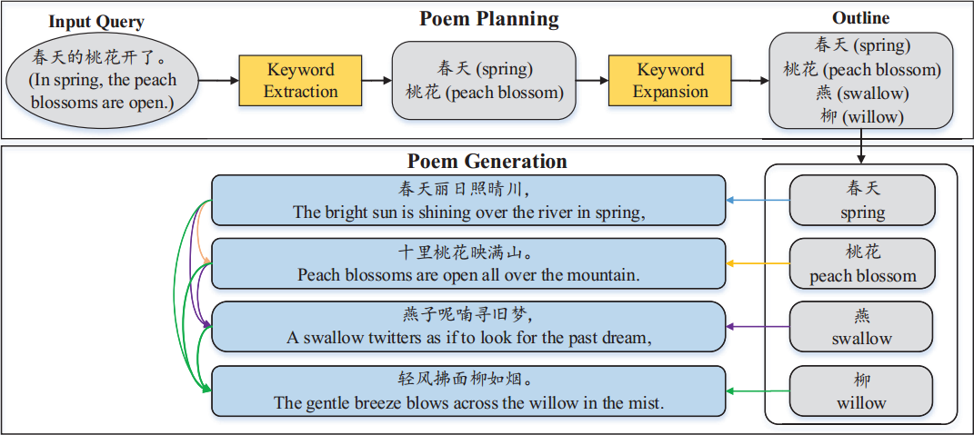
APPROACH
Overview
Notes:
我们在写诗前要先写一个提纲梗概，所以算法首先生成一个梗概，然后是整首诗。两个阶段的生成过程如图所示

Slide 9
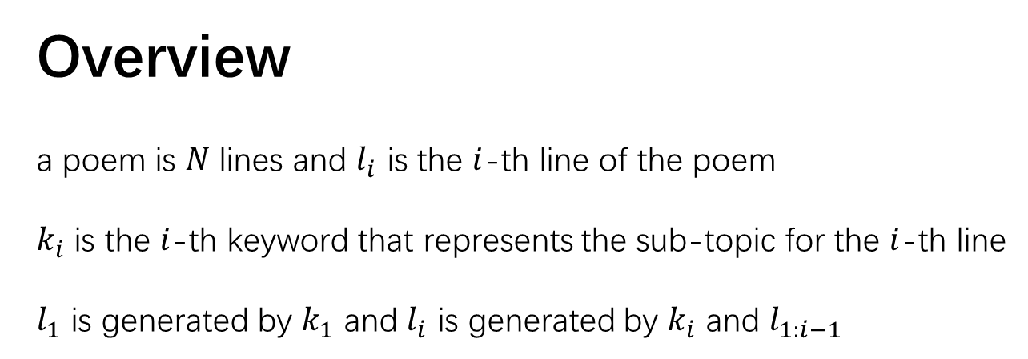
APPROACH
Overview
a poem is $N$ lines and $l_{i}$ is the $i$-th line of the poem
$k_{i}$ is the $i$-th keyword that represents the sub-topic for the $i$-th line
$l_{1}$ is generated by $k_{1}$ and $l_{i}$ is generated by $k_{i}$ and $l_{1:i−1}$
Notes:
假设一首诗由N行组成，li是第i行
那么对应地就有N个关键字，ki是对应第i行的第i个关键字

Slide 10



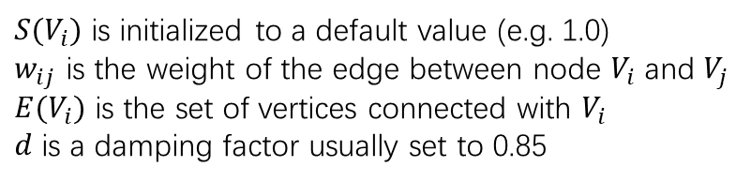
APPROACH
Poem Planning
1. Keyword Extraction
TextRank algorithm (Mihalcea and Tarau, 2004)
graph-based ranking algorithm based on PageRank
$$V_{j}$$
$$V_{i}$$
$$w_{ij}$$
$S(V_{i})$ is initialized to a default value (e.g. 1.0)
$w_{ij}$ is the weight of the edge between node $V_{i}$ and $V_{j}$
$E(V_{i})$ is the set of vertices connected with $V_{i}$
$d$ is a damping factor usually set to 0.85
Notes:
第一步是生成诗句个数的关键字，首先要从作者输入的写作意图中提取出能代表作者意图的关键字
如果输入过长，有多于诗句个数个关键字，算法
采用称作TextRank的基于PageRank的图打分算法来对关键词进行打分，取前N个关键字
算法将词汇与共现信息绘制到图中，通过该公式来迭代计算每个词的打分。基本思路是通过相邻节点的打分来计算当前节点的打分
S是每个节点的打分，最先初始化为一个值
w是两个词之间的权重衡量
E是与某个节点相邻的节点集合
d是阻尼系数

Slide 11
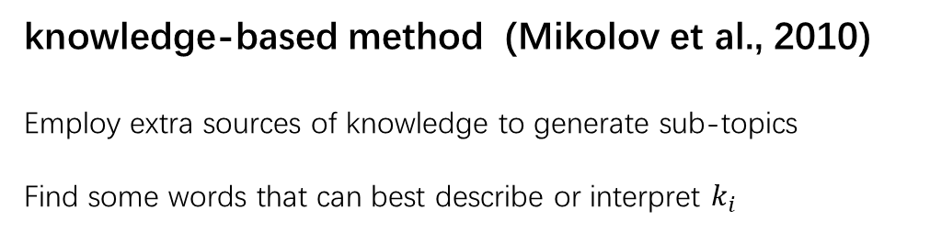
APPROACH
Poem Planning
2. Keyword Expansion
RNNLM-based method (Mikolov et al., 2010)
knowledge-based method (Mikolov et al., 2010)
Employ extra sources of knowledge to generate sub-topics
Find some words that can best describe or interpret $k_{i}$
Notes:
如果输入过短，关键字个数不够，可以使用基于RNNLM的方法和基于知识的方法来进行关键词扩充
RNNLM的训练集是一系列从诗中提取出的关键词序列。生成训练集的方法是从诗句中提取关键词，并通过TextRank选择每句中最高得分的关键词。
基于RNNLM的方法只适合生成已存在的主题关键词，对于不在训练集中的关键词，该方法就无能为力了。因此，论文采用了基于知识的方法，引入了外部数据来生成子主题关键词
找到满足以下条件的词：1.词在[-5,5]的窗口之间，2.磁性是形容词或名词 3.词在古诗语料库中，然后从中选择打分最高的词作为关键词

Slide 12
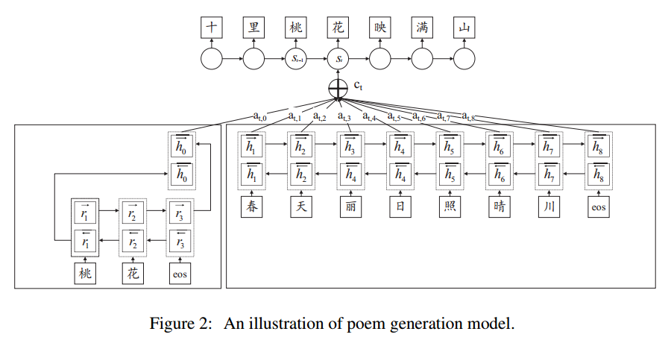
APPROACH
Poem Generation
Notes:
这是模型的结构图，整体由两个双向GRU与一个单向GRU构成

Slide 13

APPROACH
Poem Generation
Process the Keyword
keywords $k$ has $T_{k}$ characters, i.e. $k=(a_{1},a_{2},…,a_{T_{k}})$
encode $k$ into hidden states $\left[r_{1}:r_{T_{k}}\right]$ by
bi-directional Gated Recurrent Unit(GRU)(Cho et al., 2014)
integrate $\left[r_{1}:r_{T_{k}}\right]$ into a vector $r_{c}$ using the last forward state
and the first backward state
$$r_{c}=[\begin{matrix}\overset{→}{r_{T_{k}}} \\ \overset{←}{r_{1}}\end{matrix}]$$
set $h_{0}=r_{c}$
Notes:
首先对关键词进行处理，将其每个字输入第一个GRU中，得到一系列隐状态，将正向末状态与逆向始状态结合作为一个向量

Slide 14

APPROACH
Poem Generation
Process the Preceding Text
preceding text $x$ has $T_{x}$ characters, i.e.$x= \left(x_{1},x_{2},…,x_{T_{x}}\right)$
encode $x$ into $\left[h_{1}:h_{T_{k}}\right]$
integrate $\left[h_{1}:h_{T_{x}}\right]$ into vectors $h=h_{i}$ using the $i$-th forward state
and the $i$-th backward state
$$h_{i}=[\begin{matrix}\overset{→}{h_{i}} \\ \overset{←}{h_{i}}\end{matrix}]$$
Notes:
接着对当前诗句之前的诗句进行处理，类似得到一系列隐状态，将正向第i状态与逆向第i状态结合形成第i个向量

Slide 15

APPROACH
Poem Generation
Decoding
use another GRU which maintains an internal status $s_{t}$,
for each generation step, output $y_{t}$ is generated by $y_{t−1}$, context vector $c_{t}$
and current status $s_{t}$
$$y_{t}= {argmax}_{y}P(y|s_{t},c_{t},y_{t−1})$$
$s_{t}$ is updated by
$$s_{t}=f(s_{t−1},c_{t−1},y_{t−1})$$
$f$ is an activation function of GRU
Notes:
接着对输出进行解码，采用一个单向GRU，通过attention得到上下文向量与上一个字的状态来生成下一个状态，最后通过最大化对数似然函数来解码输出

Slide 16
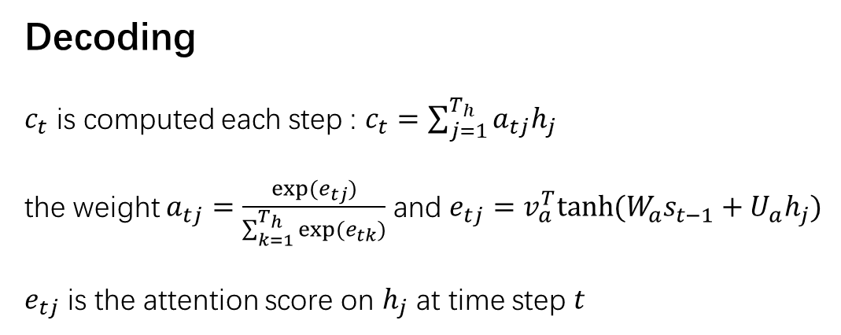
APPROACH
Poem Generation
Decoding
$c_{t}$ is computed each step : $c_{t}=\sum_{j=1}^{T_{h}}{a_{tj}h_{j}}$
the weight $a_{tj}=\frac{exp(e_{tj})}{\sum_{k=1}^{T_{h}}{exp(e_{tk})}}$ and $e_{tj}=v_{a}^{T}tanh(W_{a}s_{t−1}+U_{a}h_{j})$
$e_{tj}$ is the attention score on $h_{j}$ at time step $t$

Slide 17
EXPERIMENTS
Dataset
collect 76859 quatrains from the Internet and randomly choose 2000 poems for
validation, 2000 for testing, and the rest for training
use CRF based word segmentation system
calculate the TextRank score for every word, select the word with the highest
TextRank score as the keyword for the line
extract 72859 4-keyword sequence to train the RNNLM for keyword expansion
use Baidu Baike and Wikipedia as the extra source of knowledge
Notes:
实验部分，论文从互联网上收集了7万多的四言诗，随机抽取2000首进行验证，抽取2000首进行测试，剩下的诗用来训练神经网络
采用基于条件随机场的分词系统
每行词汇计算打分，选择打分最高的作为该句的关键词，通过7万的关键词序列去训练RNNLM

Slide 18
EXPERIMENTS
Training
6000 frequently used characters as the vocabulary
word embedding dimensionality is 512 and initialized by word2vec
the recurrent hidden layers of the encoders and decoder contained 512 hidden units
parameter were randomly initialized over a uniform distribution [-0.08,0.08]
the model was trained with the AdaDelta algorithm where the minibatch was 128
Notes:
采用6000个最频繁使用的字，利用word2vec训练为512维的word embedding，循环神经网络的隐含层也有512个单元
参数随机从-0.08到0.08的均匀分布中采样，使用AdaDelta算法进行训练，

Slide 19

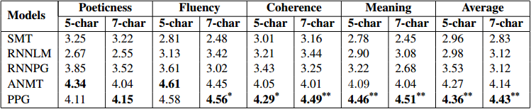
EXPERIMENTS
Evaluation
Notes:
实验结果从以下四方面来评估：
诗艺性，表示生成的诗是否符合韵律，平仄等要求
流利性，表示生成的诗读起来是否流畅流利
相干性，表示生成的诗的上下文是否相关，是否有连续的语义
意味性，表示生成的诗是否言之有物
baselines有以下几个
SMT是采用统计机器翻译算法生成诗的方法，它将上一句翻译到下一句作为下一句的诗
RNNLM是生成序列的循环神经网络语言模型，它将诗的行连在一起作为一个文字序列去训练RNNLM
RNNPG是基于RNN的Poem Generator，生成第一句诗的方法类似于RNNLM，其他诗句由上下文向量生成
ANMT是基于attention机制的神经机器翻译方法，类似于SMT，它将问题看作是机器翻译工作，不同点在于它的机器翻译系统是一个标准的基于attention的编解码框架

Slide 20
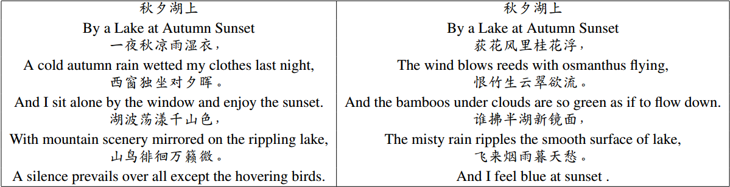
EXPERIMENTS
Blind Test
Notes:
生成20首诗，有40个测试人员，4位是专业中国文学研究员/中国文学专业学生(were professional in Chinese literature)在专业组

Slide 21
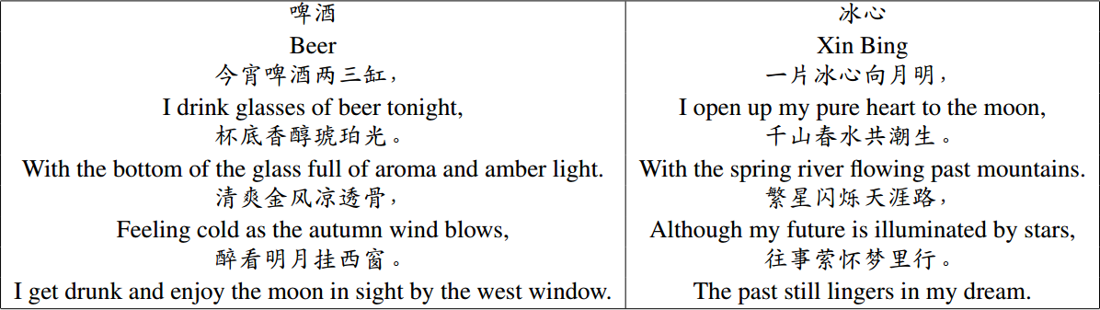
EXPERIMENTS
Generate Poems from Modern Concepts

Slide 22
CONCLUSION AND FUTURE WORK
Notes:
将来的工作重点在主题方面，考虑如何将PLSA，LDA或者word2vec用来处理主题信息，并且要把应用面扩展，用在其他文体诸如宋词元曲或者其他语言的诗上。

Slide 23
THANKS
PPT模板下载：www.1ppt.com/moban/ 行业PPT模板：www.1ppt.com/hangye/
节日PPT模板：www.1ppt.com/jieri/ PPT素材下载：www.1ppt.com/sucai/
PPT背景图片：www.1ppt.com/beijing/ PPT图表下载：www.1ppt.com/tubiao/
优秀PPT下载：www.1ppt.com/xiazai/ PPT教程： www.1ppt.com/powerpoint/
Word教程： www.1ppt.com/word/ Excel教程：www.1ppt.com/excel/
资料下载：www.1ppt.com/ziliao/ PPT课件下载：www.1ppt.com/kejian/
范文下载：www.1ppt.com/fanwen/ 试卷下载：www.1ppt.com/shiti/
教案下载：www.1ppt.com/jiaoan/ PPT论坛：www.1ppt.cn

